Slide 1


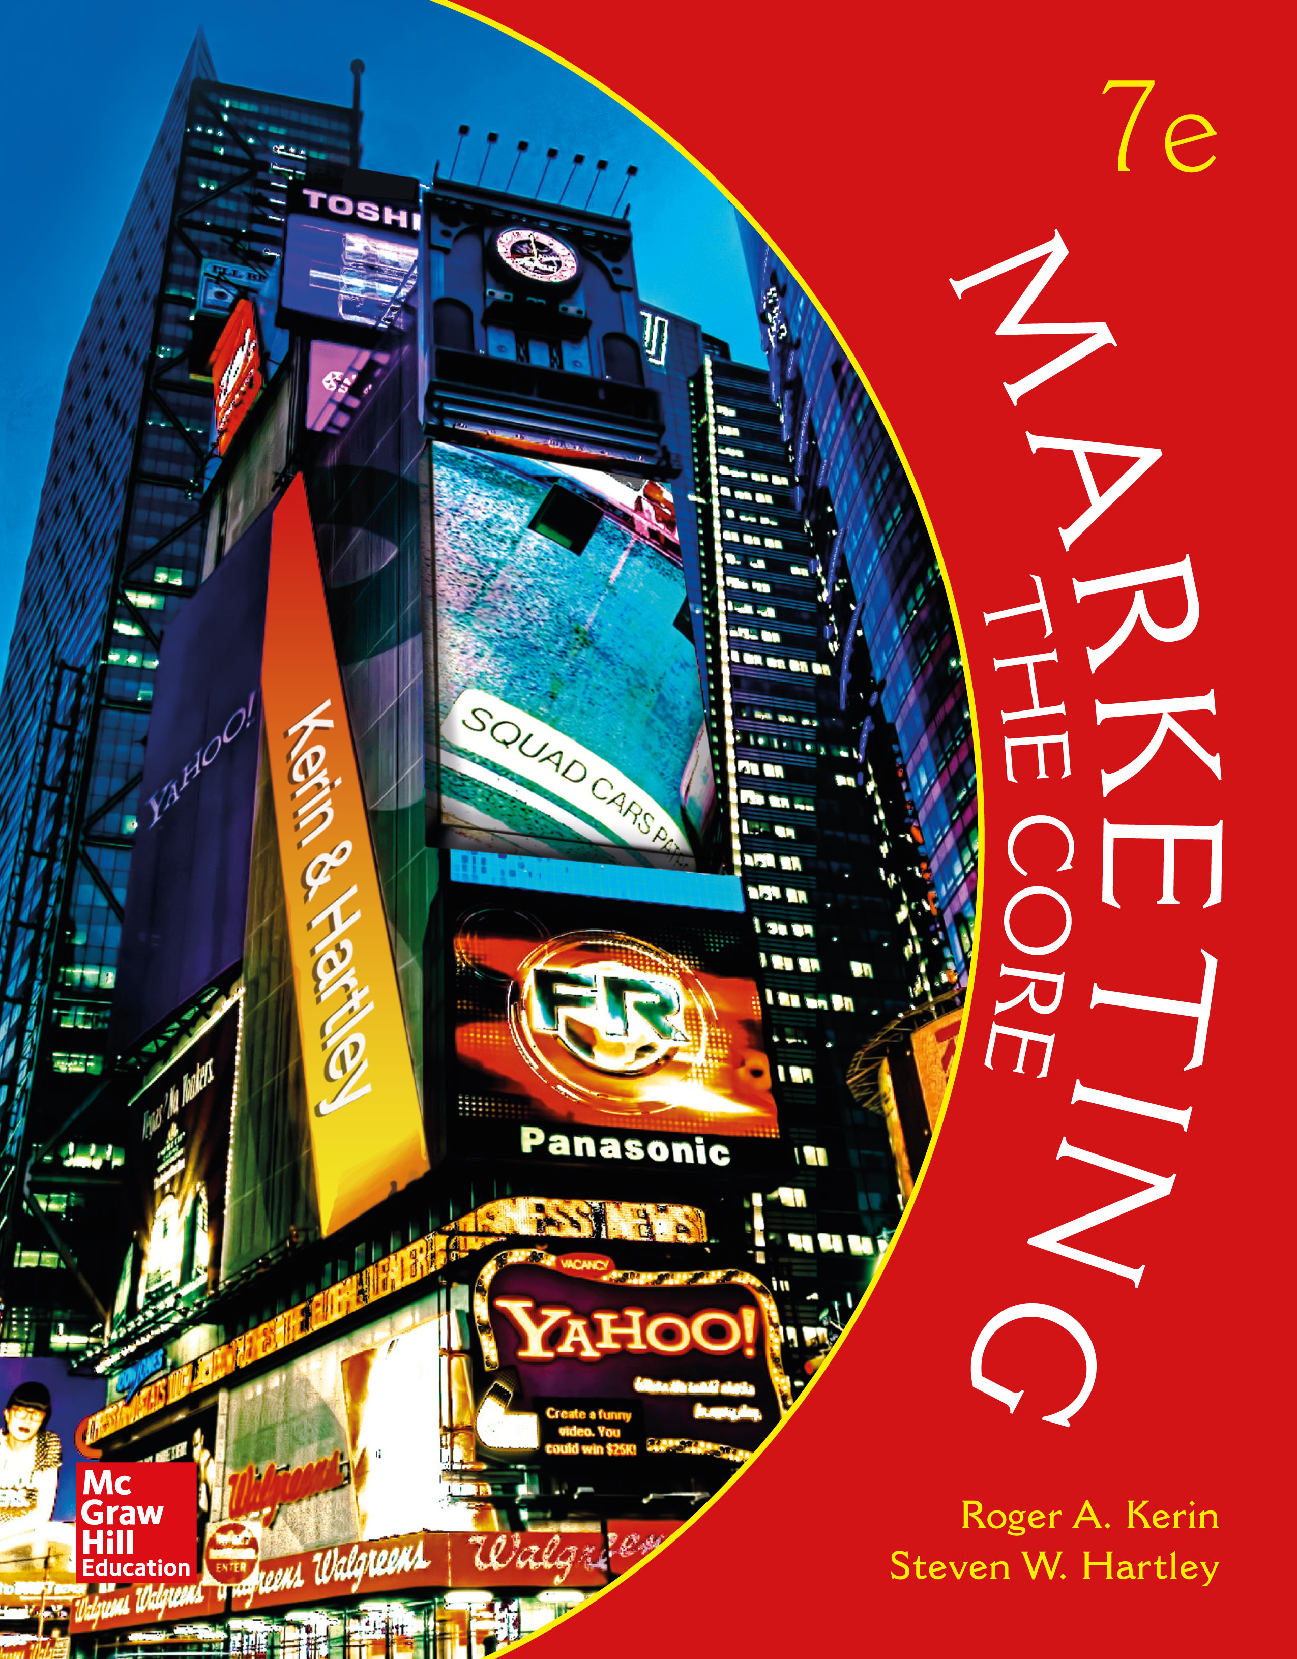
Understanding and Reaching Global Consumers and Markets

Slide 2
LEARNING OBJECTIVES (LO) AFTER READING CHAPTER 6, YOU SHOULD BE ABLE TO: (1 of 2)
1. Describe the nature and scope of world trade from a global perspective.
2. Identify the major trends that have influenced world trade and global marketing.
3. Identify the environmental forces that shape global marketing efforts.

Slide 3
LEARNING OBJECTIVES (LO) AFTER READING CHAPTER 6, YOU SHOULD BE ABLE TO: (2 of 2)
4. Name and describe the alternative approaches companies use to enter global markets.
5. Explain the distinction between standardization and customization when companies craft worldwide marketing programs.

Slide 4

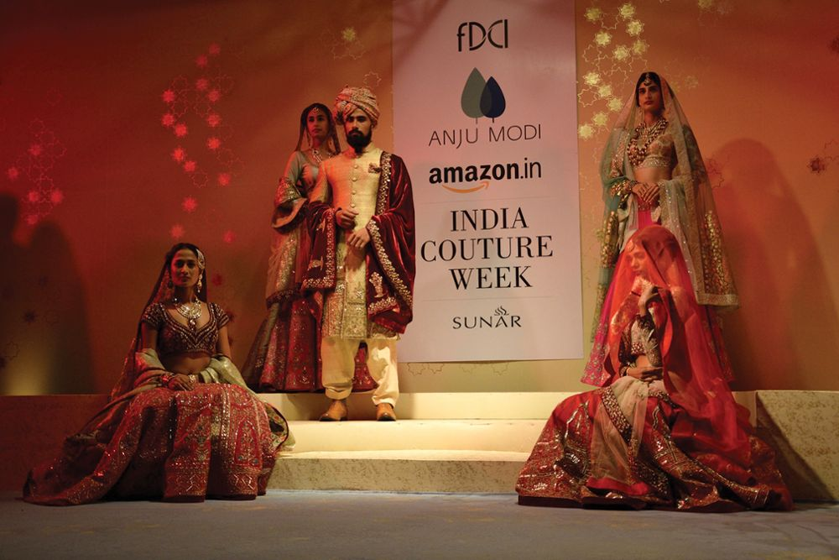

TRANSFORMING THE WAY INDIA BUYS: AMAZON BUILDS OPERATION FROM GROUND TO CLOUD
Amazon’s India
Website

Slide 5

DYNAMICS OF WORLD TRADE
Global Perspective
Value of World Trade Has Doubled
Products and Commodities: 80% of World Trade, Services: 20%
Trade Feedback Effect
Countertrade
United States Perspective
Gross Domestic Product (GDP)
Balance of Trade
Census Bureau

Slide 6
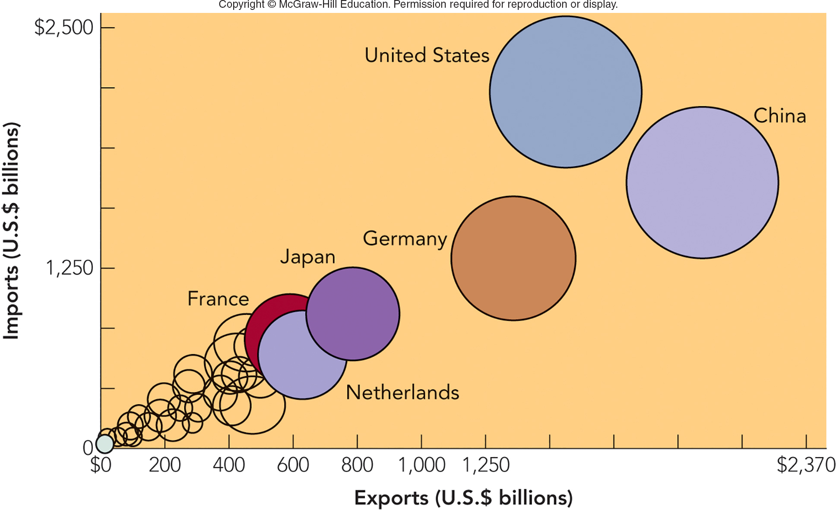
FIGURE 6-1 Leading countries in global merchandise trade in terms of imports (U.S.) and exports (China).
Jump to Appendix 1 long image description

Slide 7
MARKETING IN A BORDERLESS ECONOMIC WORLD TREND 1—DECLINE OF ECONOMIC PROTECTIONISM
Protectionism
Tariffs
Quota
World Trade Organization (WTO)
World Trade
Organization

Slide 8
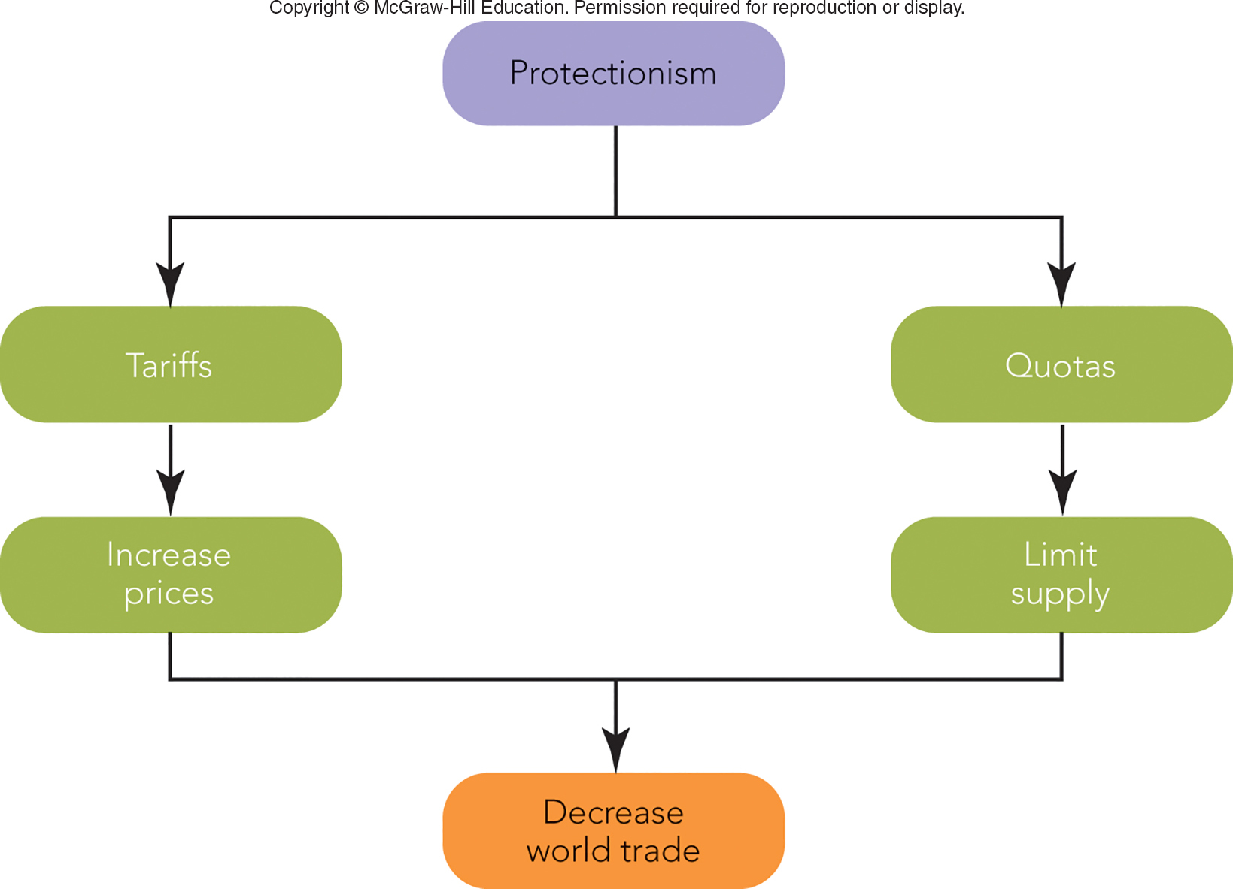
FIGURE 6-2 Protectionism hinders world trade when countries raise prices and limit supply through tariff and quota policies.
Jump to Appendix 2 long image description

Slide 9
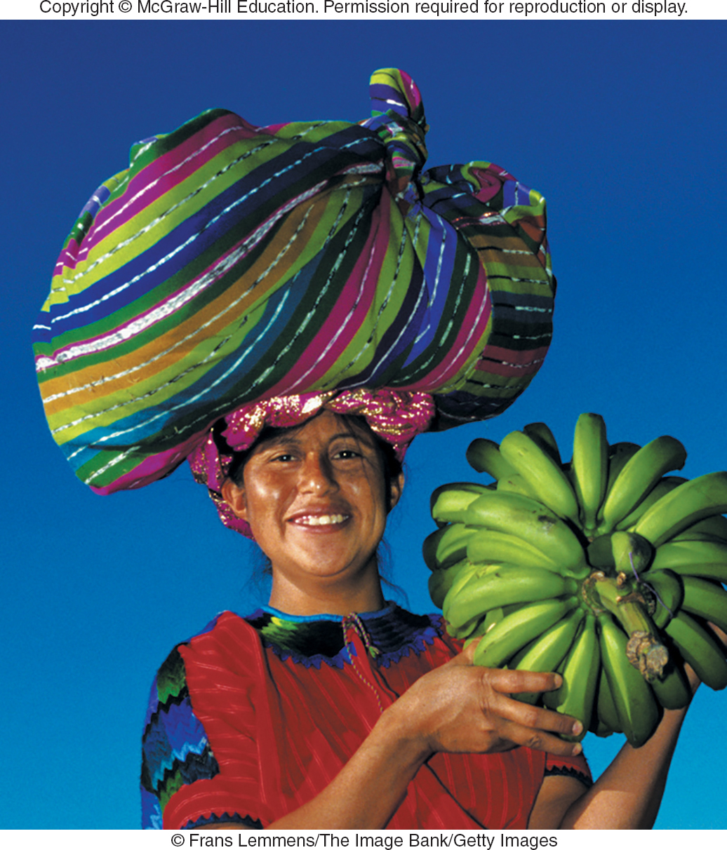
MAKING RESPONSIBLE DECISIONS GLOBAL ETHICS AND GLOBAL ECONOMICS — THE CASE OF PROTECTIONISM
Protectionism Earns Profits for Domestic Producers and Government
Japan: Consumers Pay $75-$100B/Year in Higher Prices
U.S.: $70B/Year

Slide 10
MARKETING IN A BORDERLESS ECONOMIC WORLD TREND 2—RISE OF ECONOMIC INTEGRATION
European Union (EU) – 28 Countries Eliminated Barriers to Trade
Euro (Common Currency)
North American Free Trade Agreement (NAFTA) – Lifted Trade Barriers Between Canada, Mexico, and U.S. (475 Million Consumers)
46% of U.S. Exports Are to Free Trade Partners
Euro Video

Slide 11
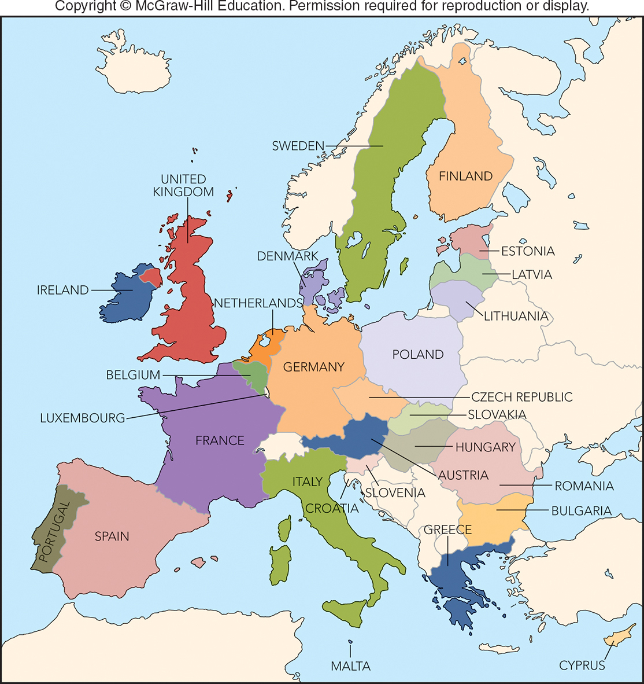
FIGURE 6-3 The European Union in 2017 consists of 28 countries with more than 500 million consumers.
European
Union countries

Slide 12

MARKETING IN A BORDERLESS ECONOMIC WORLD TREND 3—GLOBAL COMPETITION FOR GLOBAL CUSTOMERS
Global Competition
Strategic Alliances

Slide 13
FIGURE 6-A Global Companies and Marketing Strategy
TYPE OF GLOBAL COMPANY | TYPES OF MARKETING STRATEGY
International Firm | Extension of Home Marketing Strategy
Multinational Firm | Multi-domestic Marketing Strategy
Transnational Firm | Global Marketing Strategy

Slide 14

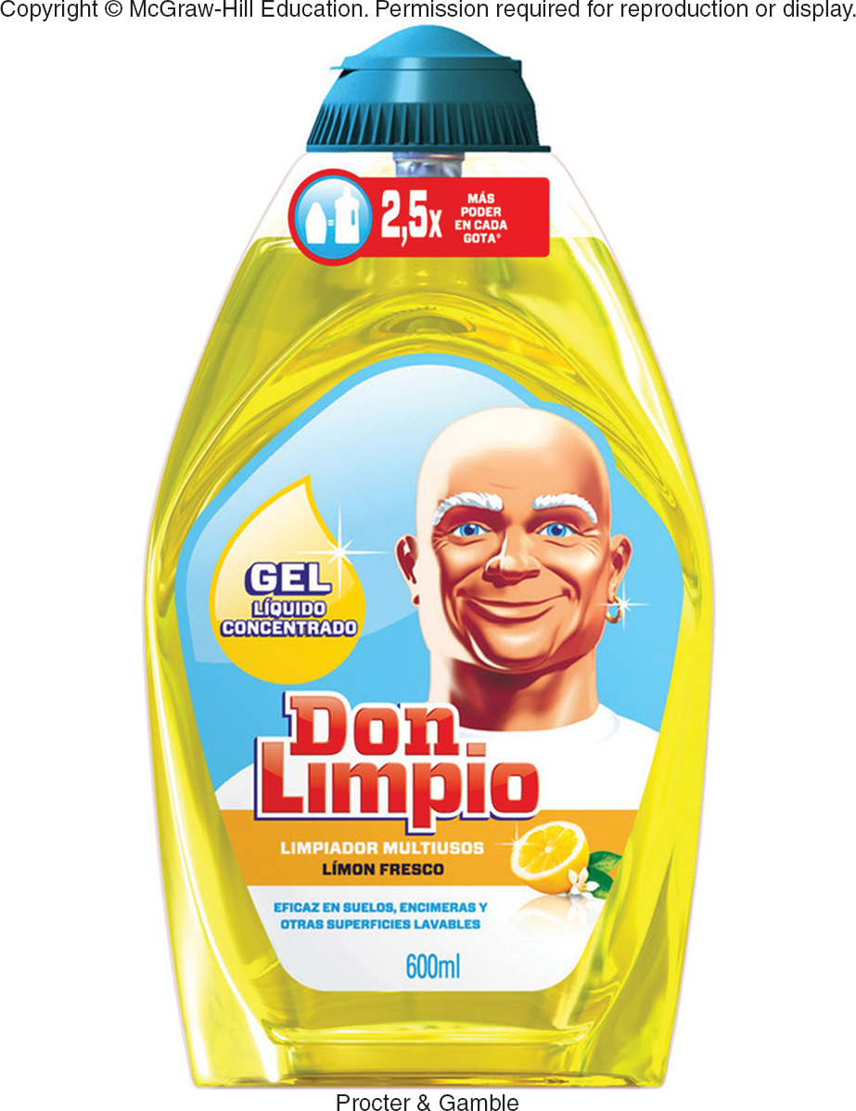

MARKETING IN A BORDERLESS ECONOMIC WORLD TREND 3—GLOBAL COMPANIES FOR GLOBAL CUSTOMERS
International Firms
Multinational Firms
Multidomestic Marketing Strategy
Transnational Firms
Global Marketing Strategy
Global Brand

Slide 15
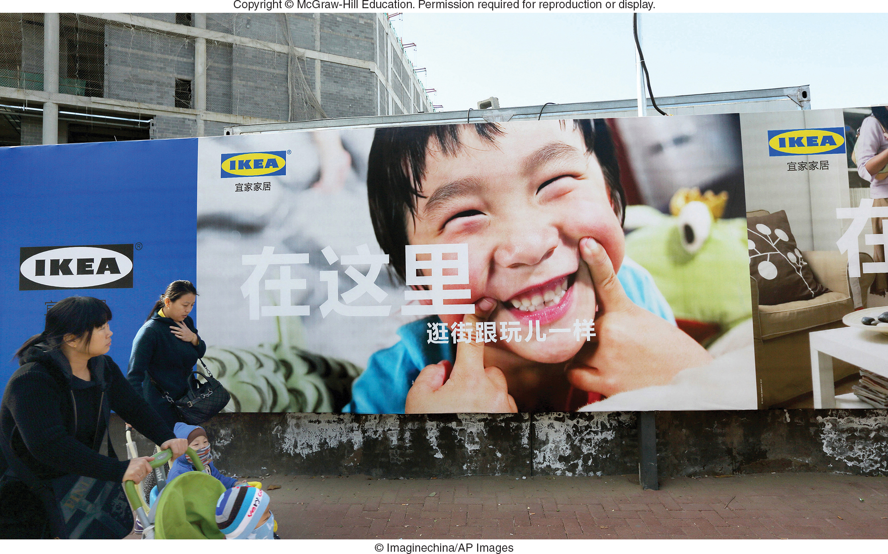
MARKETING IN A BORDERLESS ECONOMIC WORLD TREND 3—GLOBAL CUSTOMERS
Global Consumers – Consumer Groups in Different Countries with Similar Needs

Slide 16

MARKETING MATTERS The Global Teenager—A Market of 2 Billion Voracious Consumers
Global Teen Market of 2 Billion
Teens’ Rooms Look Similar No Matter the Country
Teens Spend $820B Annually for Common Products (Jeans, Video Games, etc.)

Slide 17
MARKETING IN A BORDERLESS ECONOMIC WORLD TREND 4 — NETWORKED GLOBAL MARKETPLACE
Marketspace Enables Exchange Anywhere, Anytime, and at Lower Cost
Access to Buyers on Every Continent
Nestle Hungary
Ad

Slide 18
MARKETING IN A BORDERLESS ECONOMIC WORLD TREND 5 — GROWING ECONOMIC ESPIONAGE
Economic Espionage Exists!
Clandestine Collection of Trade Secrets or Proprietary Information about Competitors
Costs U.S. Firms $250+ Billion/Year
23 Nations Routinely Target U.S. Firms
Economic Espionage Act (1996) Makes Theft a Federal Crime

Slide 19

A GLOBAL ENVIRONMENTAL SCAN CULTURAL DIVERSITY (1 of 3)
Cross-Cultural Analysis
Values
Customs
Foreign Corrupt Practices Act (1977)

Slide 20
FIGURE 6-B Cultural Appreciation
Aspects of Culture
Values
Customs
Symbols
Language

Slide 21
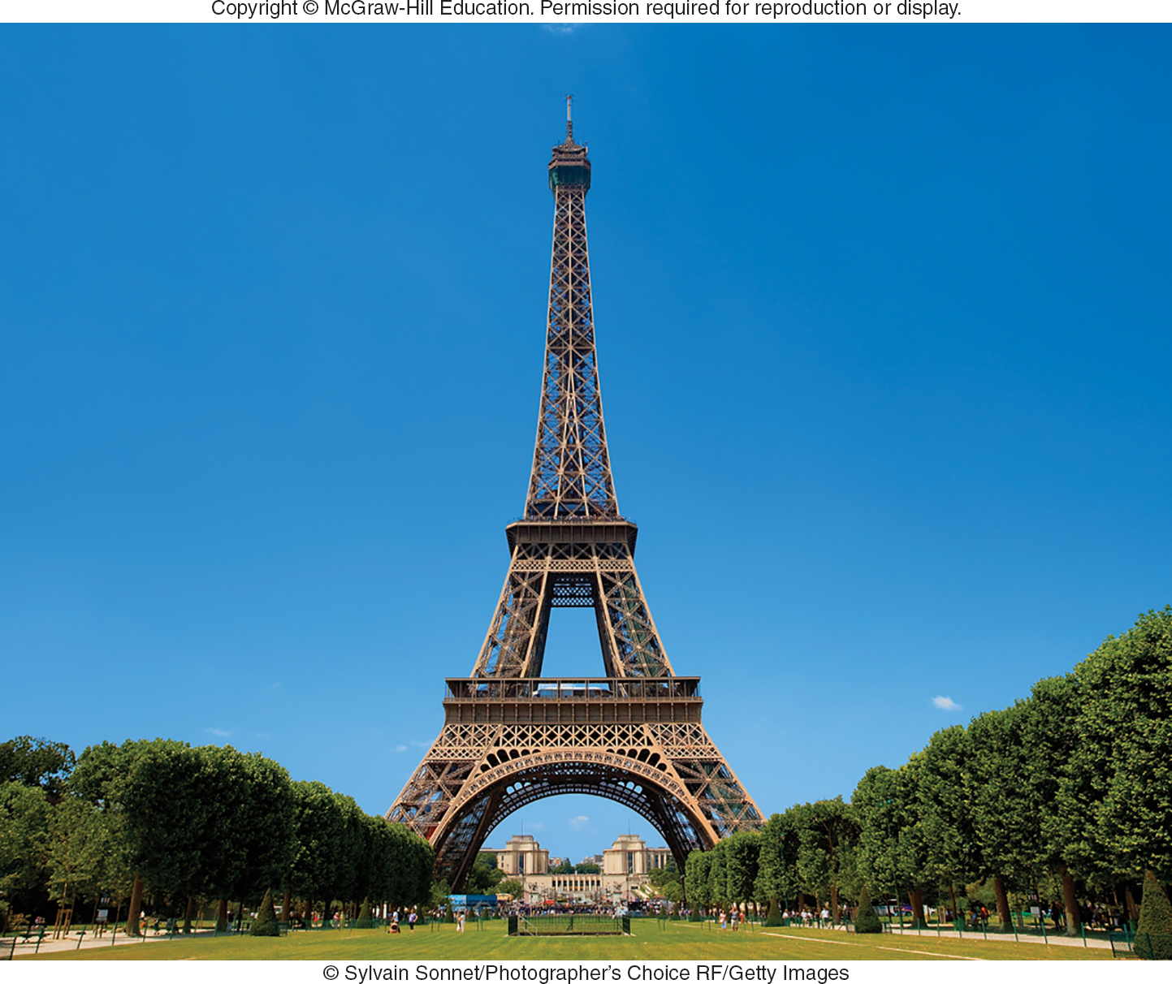
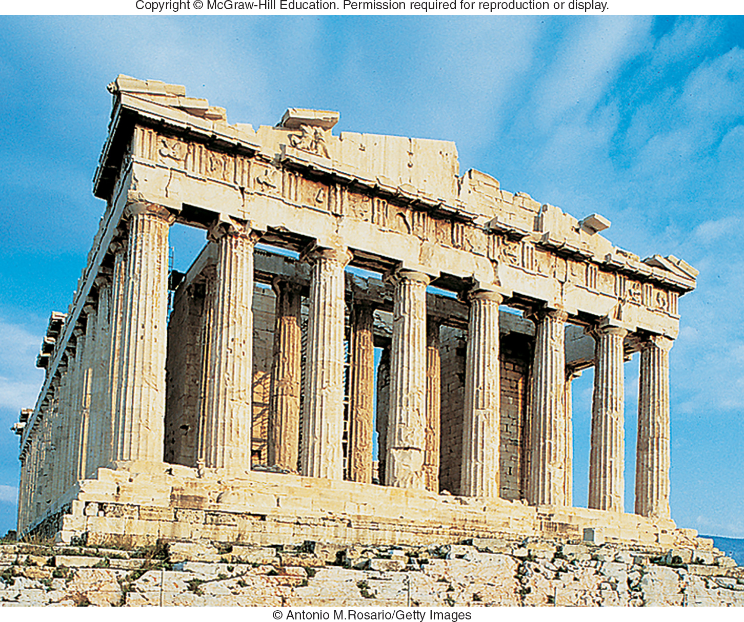
A GLOBAL ENVIRONMENTAL SCAN CULTURAL DIVERSITY (2 of 3)
Cultural Symbols – Evoke Deep Feelings

Slide 22


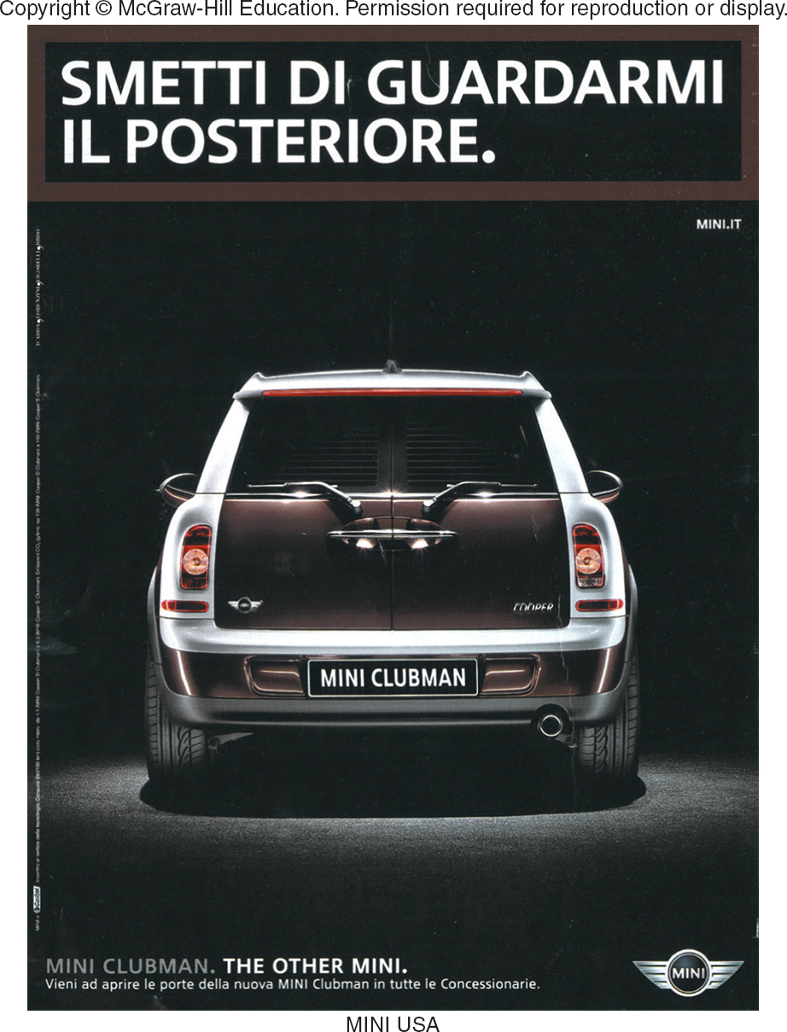
A GLOBAL ENVIRONMENTAL SCAN CULTURAL DIVERSITY (3 of 3)
Language
Unintended Meanings
Back Translation
Japanese Translation:
“Surely Win”
Nestle Japan
Ad
Italian translation:
“Stop Looking at My Rear”
Jump to Appendix 3 long image description

Slide 23

A GLOBAL ENVIRONMENTAL SCAN ECONOMIC CONSIDERATIONS (1 of 2)
Economic and Communication Infrastructure Crucial to Marketing
Example: PepsiCo Invested $1.5 Billion in Transportation and Manufacturing Systems in China and India

Slide 24

A GLOBAL ENVIRONMENTAL SCAN ECONOMIC CONSIDERATIONS (2 of 2)
Financial and Legal Systems Understanding
Consumer Income and Purchasing Power
Currency Exchange Rate
Denizen Ad

Slide 25

POLITICAL STABILITY
Billions of Dollars of Trade Lost Due to Terrorism and War
Political Stability Is Monitored and Tracked
PRS Group
Website

Slide 26
A GLOBAL ENVIRONMENTAL SCAN POLITICAL-REGULATORY CLIMATE
Impacts of Political Stability
Impact on Economy from Trade Regulations

Slide 27
COMPARING MARKET-ENTRY STRATEGIES ALTERNATIVE APPROACHES
Exporting
Indirect Exporting
Direct Exporting
Licensing
Joint Venture
Direct Investment

Slide 28
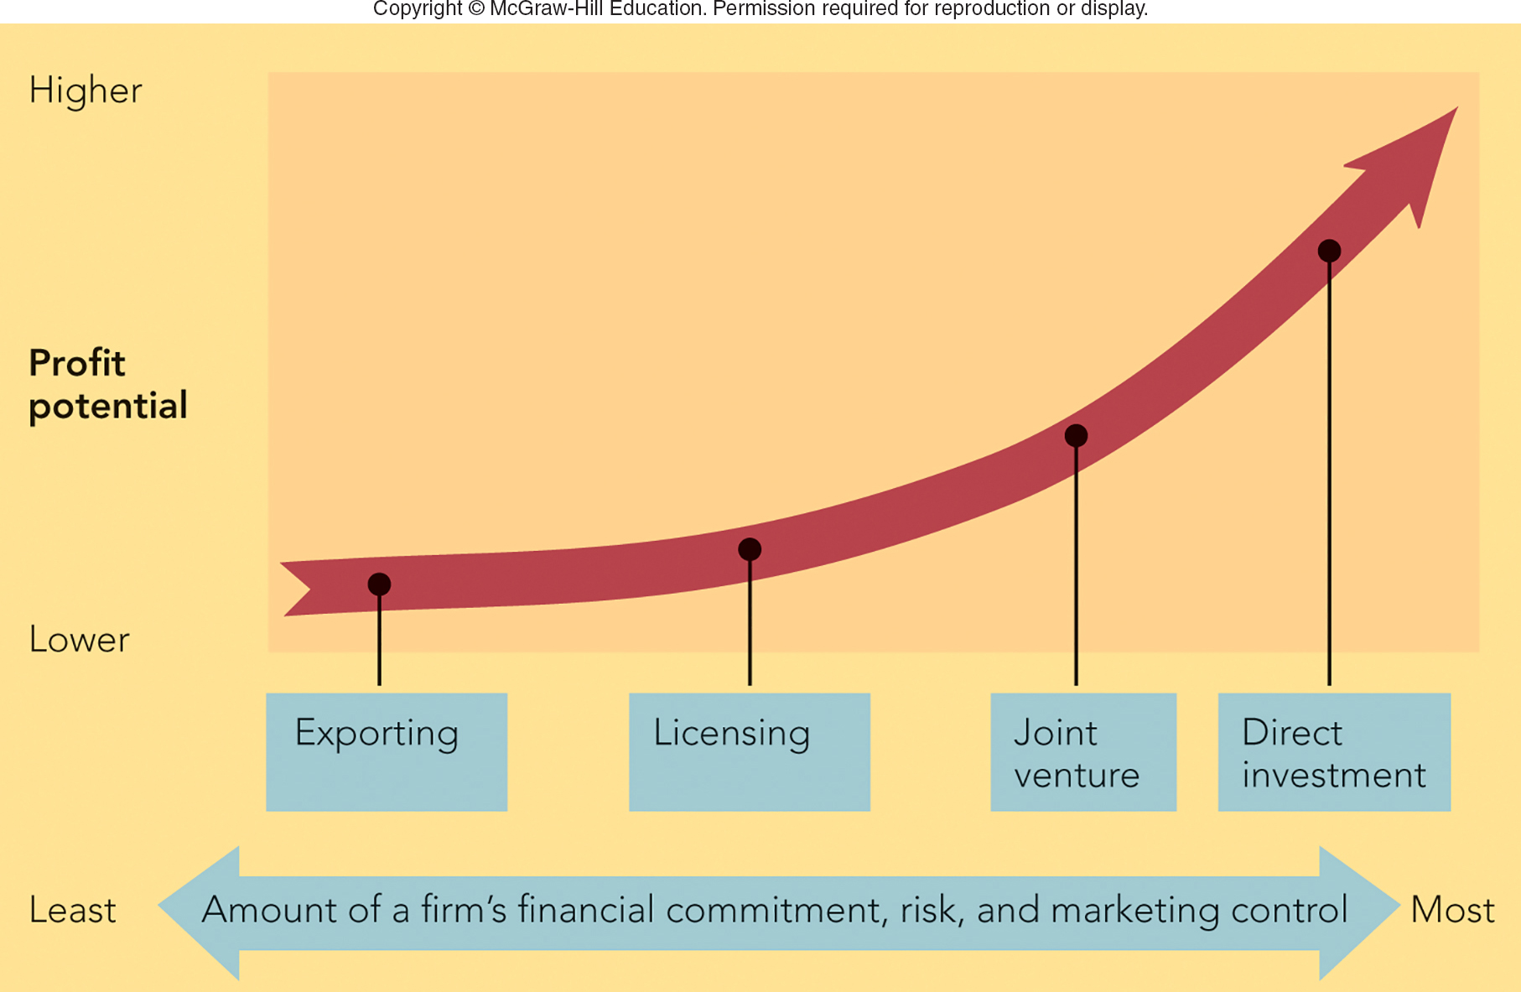
FIGURE 6-4 Alternative global market-entry strategies
Jump to Appendix 4 long image description

Slide 29
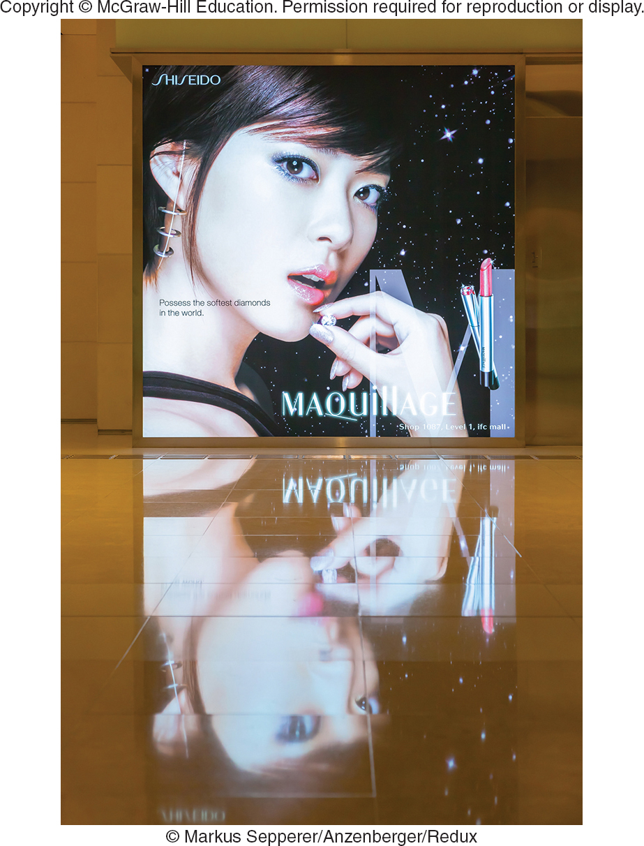
MARKETING MATTERS Creative Cosmetics and Creative Export Marketing in Japan
How to Sell in Japan?
Top Quality Product
Effective Advertising
Sell Through Network of Japanese Distributors to Reach Beauty Salons
Fran Wilson
Website

Slide 30
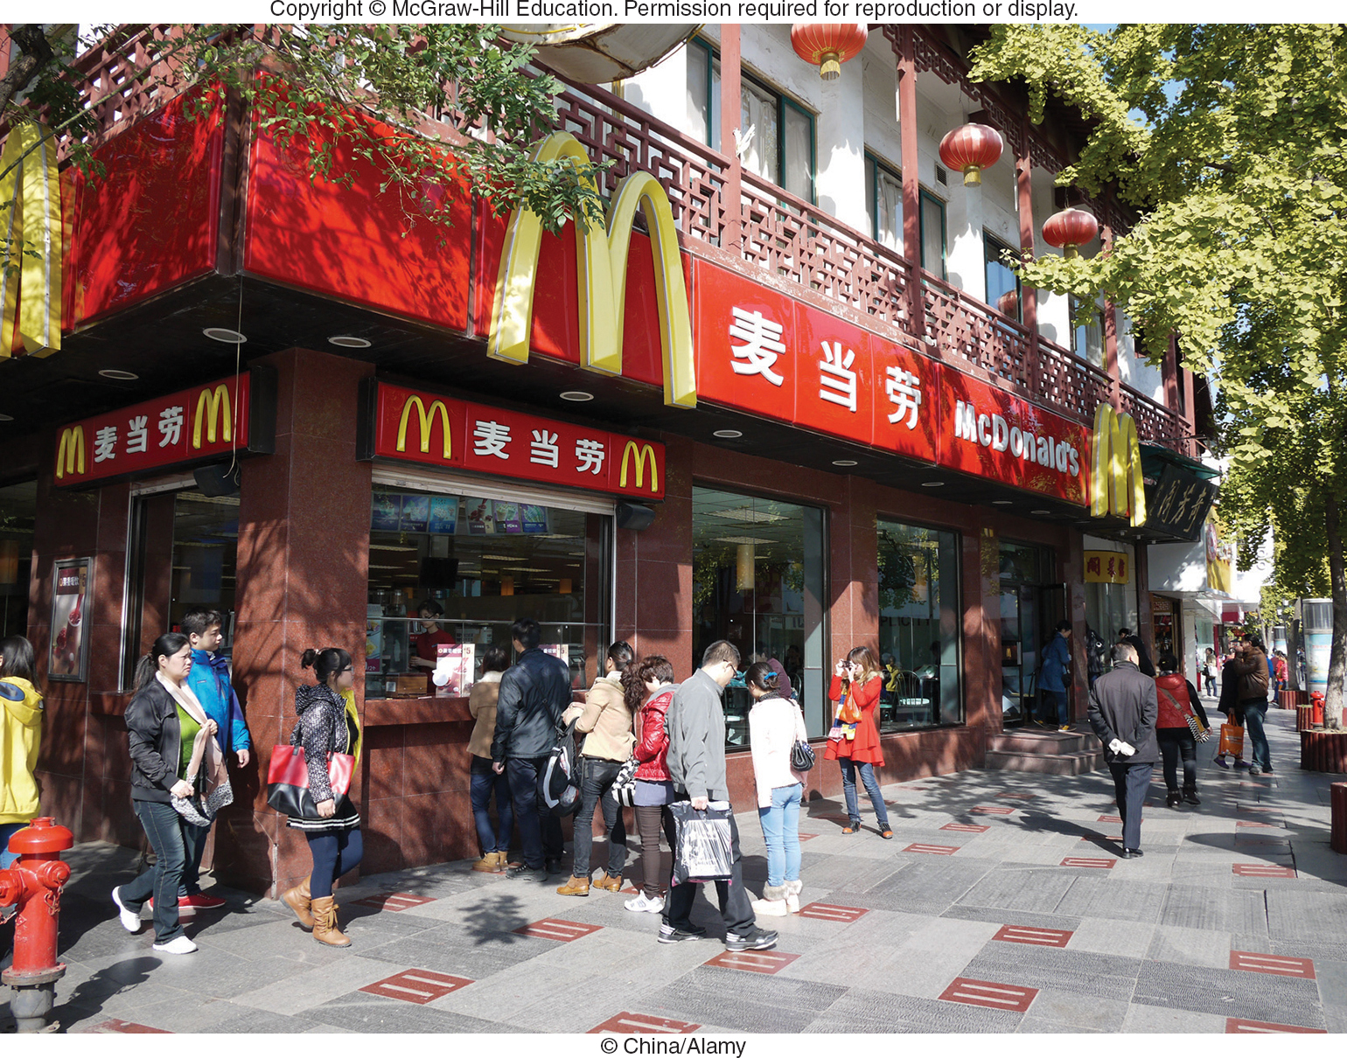
GLOBAL MARKET-ENTRY STRATEGIES LICENSING
Licensing
Advantages
Disadvantages
Contract
Manufacturing
Contract Assembly
Franchising

Slide 31
GLOBAL MARKET-ENTRY STRATEGIES JOINT VENTURE
Joint Venture
Sharing Ownership, Control, and Profits
Advantages and Disadvantages?
Direct Investment
Biggest Commitment to Enter Global Market
Advantages and Disadvantages?

Slide 32
CRAFTING A WORLDWIDE MARKETING PROGRAM PRODUCT AND PROMOTION STRATEGIES (1 of 2)
Product Extension – Same Product, Different Countries
Product Adaptation – Change Product for Different Countries
Product Invention – New Product for Different Countries

Slide 33
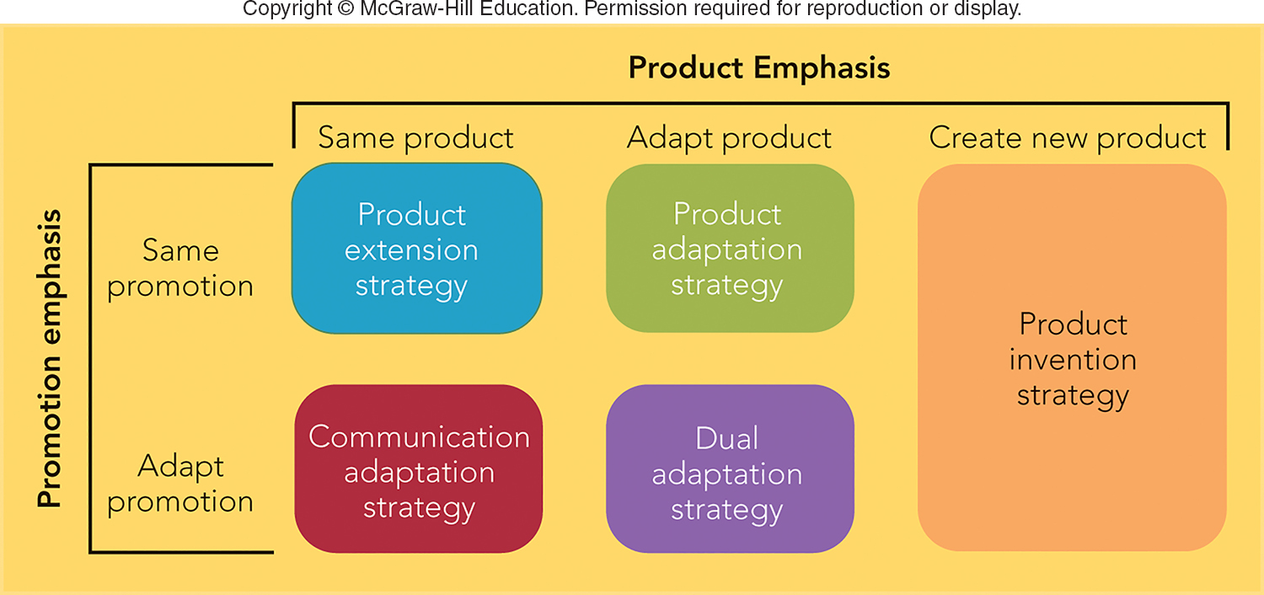
FIGURE 6-5 Five product and promotion strategies for global marketing
Jump to Appendix 5 long image description

Slide 34



CRAFTING A WORLDWIDE MARKETING PROGRAM PRODUCT AND PROMOTION STRATEGIES (2 of 2)
Identical Message
Communication Adaptation
Dual Adaptation
Nescafe China

Slide 35
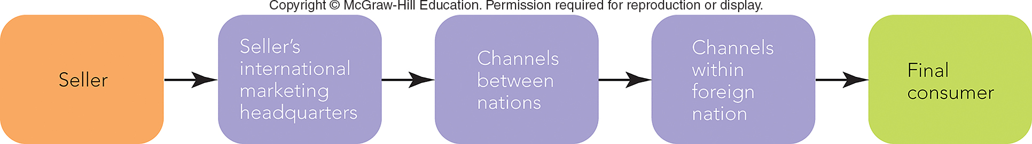
FIGURE 6-6 Channels of distribution in global marketing
Jump to Appendix 6 long image description

Slide 36
CRAFTING A WORLDWIDE MARKETING PROGRAM DISTRIBUTION AND PRICING STRATEGIES
Channels and Economic Development
Channels Can Be Long or Short
Countries Impose Pricing Constraints
Prices May Be Too High or Too Low
Dumping
Gray Market (Also Called Parallel Importing)

Slide 37

VIDEO CASE 7 MARY KAY, INC.: BUILDING A BRAND IN INDIA
Mary Kay
Video Case

Slide 38
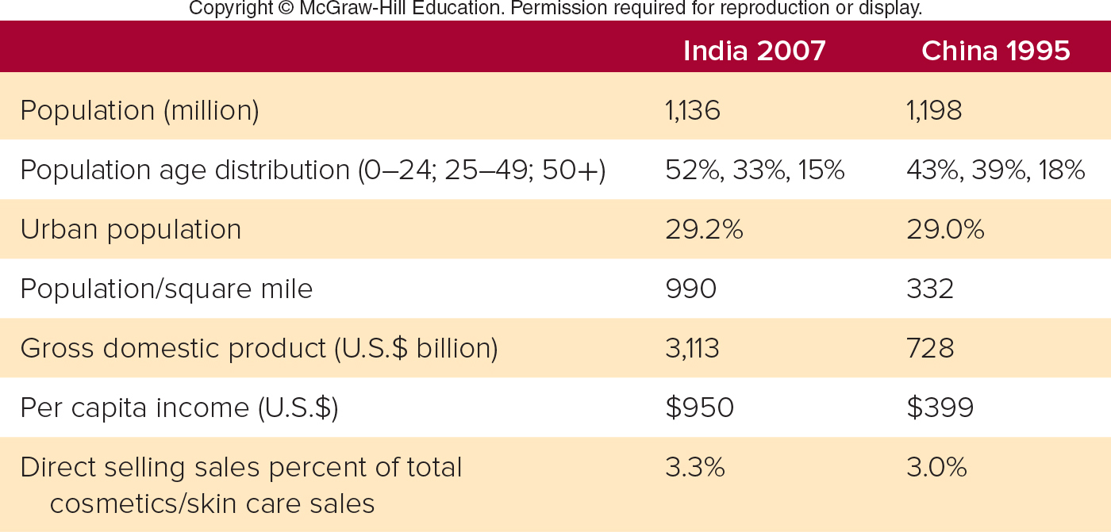
FIGURE 1 Social and economic statistics for India in 2007 and China in 1995
Jump to Appendix 7 long image description

Slide 39
VIDEO CASE 7 Mary Kay (1 of 3)
Is Mary Kay an international firm, a multinational firm, or a transnational firm based on its marketing strategy? Why?

Slide 40
VIDEO CASE 7 Mary Kay (2 of 3)
What global market-entry strategy did Mary Kay use when it entered India?

Slide 41
VIDEO CASE 7 Mary Kay (3 of 3)
Is Mary Kay a global brand? Why or why not?

Slide 42
IN-CLASS ACTIVITY 6-1
INTRODUCING CARMEX HEALING CREAM TO EUROPEAN MARKETS

Slide 43
ICA 6-1 Carmex Healing Cream (U.S. to European Markets)
Example: Introducing Carmex Healing Cream to European Markets.
Carmex Video

Slide 44
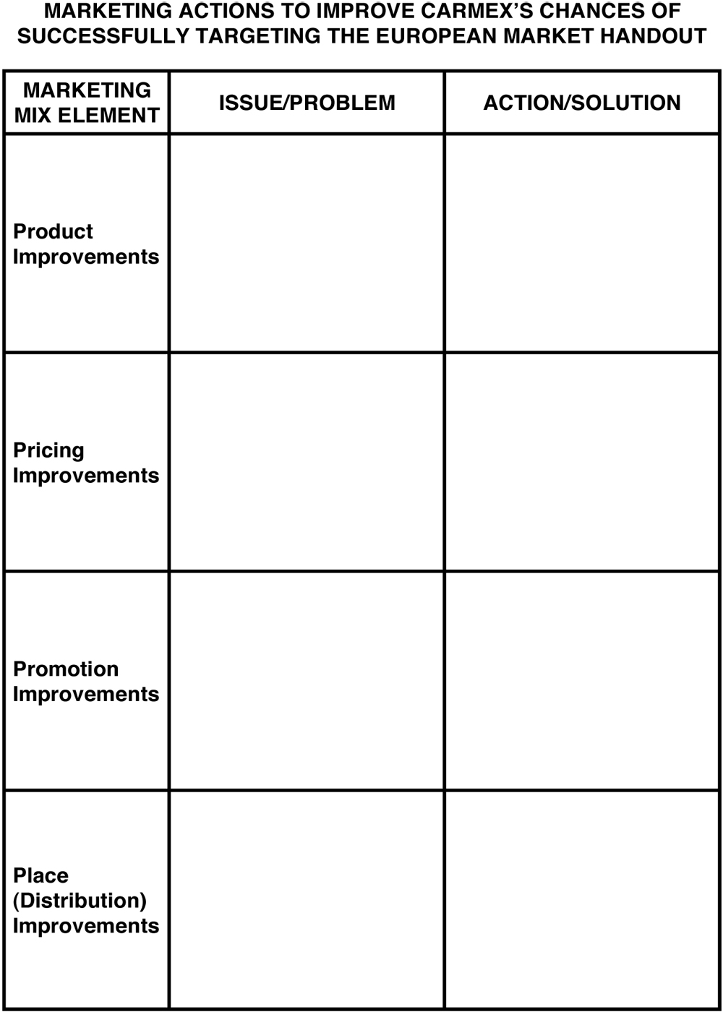
Carmex Handout.

Slide 45
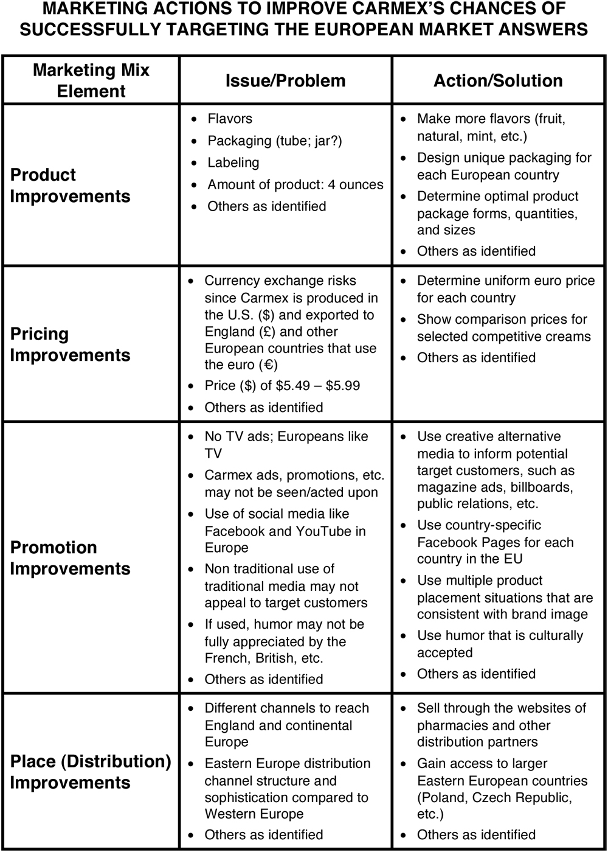
Carmex Handout Answers.

Slide 46


Countertrade
Countertrade is the practice of using barter rather than money for making global sales.

Slide 47
Gross Domestic Product (GDP)
Gross domestic product (GDP) is the monetary value of all products and services produced in a country during one year.

Slide 48
Balance of Trade
Balance of trade is the difference between the monetary value of a nation’s exports and imports.

Slide 49
Economic Espionage Act (1996)
The Economic Espionage Act (1996) is a law that makes the theft of trade secrets by foreign entities a federal crime in the United States.

Slide 50
Protectionism
Protectionism is the practice of shielding one or more industries within a country’s economy from foreign competition through the use of tariffs or quotas.

Slide 51
Tariffs
Tariffs are government taxes on products or services entering a country that primarily serve to raise prices on imports.

Slide 52
Quota
A quota is a restriction placed on the amount of a product allowed to enter or leave a country.

Slide 53
World Trade Organization (WTO)
The World Trade Organization (WTO) is a permanent institution that sets rules governing trade between its members through panels of trade experts who decide on trade disputes between members and issue binding decisions.

Slide 54
Global Competition
Global competition exists when firms originate, produce, and market their products and services worldwide.

Slide 55
Strategic Alliances
Strategic alliances are agreements among two or more independent firms to cooperate for the purpose of achieving common goals such as a competitive advantage or customer value creation.

Slide 56
Multidomestic Marketing Strategy
A multidomestic marketing strategy involves multinational firms that have as many different product variations, brand names, and advertising programs as countries in which they do business.

Slide 57
Global Marketing Strategy
A global marketing strategy involves transnational firms that employ the practice of standardizing marketing activities when there are cultural similarities and adapting them when cultures differ.

Slide 58
Global Brand
A global brand is a brand marketed under the same name in multiple countries with similar and centrally coordinated marketing programs.

Slide 59
Global Consumers
Global consumers are consumer groups living in many countries or regions of the world who have similar needs or seek similar features and benefits from products or services.

Slide 60
Cross-Cultural Analysis
Cross-cultural analysis involves the study of similarities and differences among consumers in two or more nations or societies.

Slide 61
Values
Values are a society’s personally or socially preferable modes of conduct or states of existence that tend to persist over time.

Slide 62
Customs
Customs are what is considered normal and expected about the way people do things in a specific country.

Slide 63
Foreign Corrupt Practices Act (1977)
The Foreign Corrupt Practices Act (1977) is a law, amended by the International Anti-Dumping and Fair Competition Act (1998), that makes it a crime for U.S. corporations to bribe an official of a foreign government or political party to obtain or retain business in a foreign country.

Slide 64
Cultural Symbols
Cultural symbols are things that represent ideas and concepts.

Slide 65
Back Translation
Back translation is the practice where a translated word or phrase is retranslated into the original language by a different interpreter to catch errors.

Slide 66
Currency Exchange Rate
A currency exchange rate is the price of one country’s currency expressed in terms of another country’s currency.

Slide 67
Exporting
Exporting is a global market-entry strategy in which a company produces products in one country and sells them in another country.

Slide 68
Joint Venture
Joint venture is a global market-entry strategy in which a foreign company and a local firm invest together to create a local business in order to share the ownership, control, and profits of the new company.

Slide 69
Direct Investment
Direct investment is a global market-entry strategy that entails a domestic firm actually investing in and owning a foreign subsidiary or division.

Slide 70
Dumping
Dumping occurs when a firm sells a product in a foreign country below its domestic price or below its actual cost.

Slide 71
Gray Market
A gray market is a situation where products are sold through unauthorized channels of distribution. Also called parallel importing.

Slide 72
Appendix 1 FIGURE 6-1 Leading countries in global merchandise trade in terms of imports (U.S.) and exports (China).
From lowest to highest, the graph plots France, the Netherlands, Japan, Germany, the U.S., and China based on their imports and exports. The graph shows France imports slightly more than the Netherlands, and the U.S. imports more than China, with Germany in the middle.
Return to slide

Slide 73
Appendix 2 FIGURE 6-2 Protectionism hinders world trade when countries raise prices and limit supply through tariff and quota policies.
Protectionism breaks into two branches. Tariffs lead to an increase in prices, while quotas limit supply. Both branches lead to a decrease in world trade.
Return to slide

Slide 74
Appendix 3 A GLOBAL ENVIRONMENTAL SCAN CULTURAL DIVERSITY
Two advertisements, one English, one Italian, show the same rear shot of a Mini Cooper. The English ad's copy reads “stop staring at my boot,” while the Italian ad translates to “stop looking at my rear.”
Return to slide

Slide 75
Appendix 4 FIGURE 6-4 Alternative global market-entry strategies
Four stages are shown.
The first stage, exporting, has low profit potential and the least amount of control.
The second stage, licensing, increases in profit potential and control.
The third stage, joint venture, sees a marked increase in profit potential and control.
The fourth stage, direct investment, sees the highest amounts of profit potential and control.
Return to slide

Slide 76
Appendix 5 FIGURE 6-5 Five product and promotion strategies for global marketing
Five product and promotion strategies are based on combinations of product emphasis and promotion emphasis.
Product extension strategy (same product, same promotion).
Communication adaption strategy (same product, adapt promotion).
Product adaption strategy (adapt product, same promotion).
Dual adaption strategy (adapt product, adapt promotion).
Product invention strategy (create new product, same promotion or adapt promotion).
Return to slide

Slide 77
Appendix 6 FIGURE 6-6 Channels of distribution in global marketing
The channels of distribution start with the seller, then go to the seller's international marketing headquarters, followed by the channels between nations, the channels within a foreign nation, and end with the final consumer.
Return to slide

Slide 78
Appendix 7 FIGURE 1 Social and economic statistics for India in 2007 and China in 1995
India 2007. Population 1,136 million. Population age distribution 0 to 24, 52 percent; 25 to 49, 33 percent; 50 and older, 15 percent. Urban population 29.2 percent. Population per square mile 990. Gross domestic product 3,113 billion U.S. dollars. Per capita income 950 U.S. dollars. Direct selling sales percent of total cosmetics and skin care sales 3.3 percent.
China 1995. Population 1,198 million. Population age distribution 0 to 24, 43 percent; 25 to 49, 39 percent; 50 and older, 18 percent. Urban population 29.0 percent. Population per square mile 332. Gross domestic product 728 billion U.S. dollars. Per capita income 399 U.S. dollars. Direct selling sales percent of total cosmetics and skin care sales 3.0 percent.
Return to slide

